Slide 1
New experimental design (Not shown)
Element | Item | Values | Perm.
Visual | Visualization | PCA (P), Grand tour (G), Radial manual Tour (R) | 6
Block | Location (1 signal AB, 1 noise var) | % of a noise dimension mixed with a signal : 0/100, 33/67, 50/50 | 6
Fixed parameters | VC model | Period1: EEE, period 2: EEV, period 3: banana
 | Numb. Variables & clusters | Odd reps: 4 dim & 3 clusters, even reps: 6 dim & 4 clusters
 | Correlation, of signal variable | (-).9, magnitude of off-diagonal element correlation
 | Correlation, of noise variable | 0,
 | Stating basis | PCA: 1:4, grand: random, radial: Uniform half clock (p4/p6)
 | Separation size | 2, magnitude of mean offset in signal dimensions
 | Variation size | 1, magnitude of the variation, obfuscating the signal
 | Preprocessing | All variables normalized by standard deviation
 | Observations within cluster | 140 each
Randomization | Factor | Factor order assigned base on participation number
 | Block | Location order assigned base on participation number
 | Variable order | Variables are shuffled in simulation (index stored)
6*6 = 36 permutations
per even evaluation
Even block evaluation every 6 participants, but does not have full span; Factor perm 1 never happens at Location perm 2, unless location selects on

Slide 2
















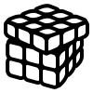




But we still don’t have the full span; factor and VC order are always in sync. Collapse factor order into 3v3 latin square, then even eval ever 3*3*6 = 56 participants.
Read the number of previous responses
Iterate number
Set the factor order and location order
Previously; 8 mod 3 = 2
Participant,
own computer
EBS shiny server
*: actually assign between randomly to any level with the min count table may prove to be the most robust simple way
Previous responses
Factor 1
Factor 2
Factor 3
x | 1+ (x-1) mod 3 | (1 + floor((x-1)/3)) mod 3 | (1 + floor((x-1)/9)) mod 6
1 | 1 | 1 | 1
2 | 2 | 1 | 1
3 | 3 | 1 | 1
4 | 1 | 2 | 1
5 | 2 | 2 | 1
6 | 3 | 2 | 1
7 | 1 | 3 | 1
8 | 2 | 3 | 1
9 | 3 | 3 | 1
10 | 1 | 1 | 2
11 | 2 | 1 | 2
12 | 3 | 1 | 2
13 | 1 | 2 | 2
Factor order
permutations
1
2
3
4
5
6
P
G
R
Factor order 1, 2, 3, 4, 5, 6
P
R
G
1st factor
2nd factor
3rd factor
P
P
R
R
G
G
R
G
P
G
R
G
P
R
R
R
P
G
R
G
P
G
P
P
G
R
P
G
P
R

Slide 3
Randomization for the 63rd participant
Set the visual order: 1 + (63 - 1) mod 6 = permutation 4; grand, PCA, & radial
Set location order: 1 + floor((63 - 1) / 6) mod 36 = permutation 3; 33/67, 50/50, & 0/100 % noise/signal mix
Fixed factors:
Variance-covariance shape increments with each period: EEE, EEV, EVV-banana
Data dimension is fixed within each period: 4 then 6
Period 1
Period 2
Period 3
Period 1
Period 2
Period 3
Period | Evaluation order | Visual ¹ | Location ² | Shape ³ | Dimensions ⁴
1 | Train 1 | Grand | 0/100 | EEE | 4 (3cl)
1 | 1 | Grand | 33/67 | EEE | 4 (3cl)
1 | 2 | Grand | 33/67 | EEE | 6 (4cl)
2 | Train 2 | PCA | 0/110 | EEE | 4 (3cl)
2 | 3 | PCA | 50/50 | EEV | 4 (3cl)
2 | 4 | PCA | 50/50 | EEV | 6 (4cl)
3 | Train 3 | Radial | 0/100 | EEE | 4 (3cl)
3 | 5 | Radial | 0/100 | Ban | 4 (3cl)
3 | 6 | Radial | 0/100 | Ban | 6 (4cl)
visual order
permutations
location order
permutations
1
2
3
4
5
6
P
G
R
1
2
3
4
5
6
1
2
3
P
R
G
1
3
2
Increment through all permutations of visual, before incrementing 1 permutation of location
G
R
P
2
3
1
G
P
R
2
1
3
R
P
G
3
1
2
R
P
G
3
2
1
Period | Evaluation order | Factor¹ | Location² | VC ³ | Data dimensions⁴ | Sim name
1 | Train 1 | Grand | 0_1 | EEE | 4 (3cl) | EEE_p4_0_1_t1
1 | 1 | Grand | 33_67 | EEE | 4 (3cl) | EEE_p4_33_67_rep1
1 | 2 | Grand | 33_67 | EEE | 6 (4cl) | EEE_p6_33_67_rep2
2 | Train 2 | PCA | 0_1 | EEE | 4 (3cl) | EEE_p4_0_1_t2
2 | 3 | PCA | 50_50 | EEV | 4 (3cl) | EEV_p4_50_50_rep3
2 | 4 | PCA | 50_50 | EEV | 6 (4cl) | EEV_p6_50_50_rep4
3 | Train 3 | Radial | 0_1 | EEE | 4 (3cl) | EEE_p4_0_1_t3
3 | 5 | Radial | 0_1 | Ban | 4 (3cl) | Ban_p4_0_1_rep5
3 | 6 | Radial | 0_1 | Ban | 6 (4cl) | Ban_p6_0_1_rep6
Even evaluation every 6*6*3*1 = 56 participants
3x training sets of EEE_4p_1_0 ; 3 training sets
3x reps from each of the 18 VC*var*location levels; 108 evaluation sets
(3 + 108) 3x factors saved as .png and .gif; 333 .png/.gif files
NEED MORE g tour paths? 3x grand tour paths; (1x p4 training, 1x p4, 1x p6)

Slide 4
Consider a new participant, the 63rd participant,
Fixed blocks:
Variance-covariance shape increments with each period: EEE, EEV, EVV-banana
Data dimension is fixed within each period: 4 then 6
Set the factor order: 1 + (63 - 1) mod 6 = permutation 4; grand, PCA, & radial
Set location order: 1 + floor((63 - 1) / 6) mod 36 = permutation 3; 33/67, 50/50, & 0/100 % noise/signal mix
OLD DESIGN
Period | Evaluation order | Factor¹ | Location² | Shape ³ | Dimensions⁴
1 | Train 1 | Grand | 0/100 | EEE | 4 (3cl)
1 | 1 | Grand | 33/67 | EEE | 4 (3cl)
1 | 2 | Grand | 33/67 | EEE | 6 (4cl)
2 | Train 2 | PCA | 0/110 | EEE | 4 (3cl)
2 | 3 | PCA | 50/50 | EEV | 4 (3cl)
2 | 4 | PCA | 50/50 | EEV | 6 (4cl)
3 | Train 3 | Radial | 0/100 | EEE | 4 (3cl)
3 | 5 | Radial | 0/100 | Ban | 4 (3cl)
3 | 6 | Radial | 0/100 | Ban | 6 (4cl)
Period 1
Period 2
Period 3
Period 1
Period 2
Period 3
factor order
permutation
location order
permutation
1
2
3
4
5
6
P
G
R
1
2
3
4
5
6
1
2
3
P
R
G
1
3
2
G
R
P
Increment through all permutations of factor, before incrementing 1 permutation of location
2
3
1
G
P
R
2
1
3
R
P
G
3
1
2
R
P
G
3
2
1
Period | Evaluation order | Factor¹ | Location² | VC ³ | Data dimensions⁴ | Sim name
1 | Train 1 | Grand | 0_1 | EEE | 4 (3cl) | EEE_p4_0_1_t1
1 | 1 | Grand | 33_67 | EEE | 4 (3cl) | EEE_p4_33_67_rep1
1 | 2 | Grand | 33_67 | EEE | 6 (4cl) | EEE_p6_33_67_rep2
2 | Train 2 | PCA | 0_1 | EEE | 4 (3cl) | EEE_p4_0_1_t2
2 | 3 | PCA | 50_50 | EEV | 4 (3cl) | EEV_p4_50_50_rep3
2 | 4 | PCA | 50_50 | EEV | 6 (4cl) | EEV_p6_50_50_rep4
3 | Train 3 | Radial | 0_1 | EEE | 4 (3cl) | EEE_p4_0_1_t3
3 | 5 | Radial | 0_1 | Ban | 4 (3cl) | Ban_p4_0_1_rep5
3 | 6 | Radial | 0_1 | Ban | 6 (4cl) | Ban_p6_0_1_rep6
Even evaluation every 6*6*3*1 = 56 participants
3x training sets of EEE_4p_1_0 ; 3 training sets
3x reps from each of the 18 VC*var*location levels; 108 evaluation sets
(3 + 108) 3x factors saved as .png and .gif; 333 .png/.gif files
NEED MORE g tour paths? 3x grand tour paths; (1x p4 training, 1x p4, 1x p6)

Slide 5
Response table, in study structure
Ui only |  |  | Ui and Response table, The keys specifying the unique participant-factor-block |  |  |  |  |  |  |  |  | Implicit |  | Response table only The measures captured during evaluation
Page | Section page | Section name | Participant number | Full perm number | Period | Eval | Factor | VC | # variable, clusters | Location | Sim name | Basis F(factor, var) | Grand path F(Factor, Var) | Control interactions | Response interactions | Time to respond | Response | Answer | Marks
1 | 1 | intro | 64 | 8 | 0 | structure | NA | NA | NA | NA | NA | NA | NA | NA | NA | NA | NA | NA | NA
2 | 2 | intro | 64 | 8 | 0 | video | NA | NA | NA | NA | NA | NA | NA | NA | NA | NA | NA | NA | NA
3 | 3 | intro | 64 | 8 | 0 | intermission | NA | NA | NA | NA | NA | NA | NA | NA | NA | NA | NA | NA | NA
4 | 1 | period1 | 64 | 8 | 1 | Training | PCA | EEE | 4v (3cl) | 0_1 | EEE_p4_0_1_t1 | PC1 x PC2 | NA | NULL | NULL | NULL | NULL | NULL | NULL
5 | 2 | period1 | 64 | 8 | 1 | 1 | PCA | EEE | 4v (3cl) | 0_1 | EEE_p4_0_1_rep1 | PC1 x PC2 | NA | NULL | NULL | NULL | NULL | NULL | NULL
6 | 3 | period1 | 64 | 8 | 1 | 2 | PCA | EEE | 6v in (4cl) | 50_50 | EEE_p6_50_50_rep2 | PC1 x PC2 | NA | NULL | NULL | NULL | NULL | NULL | NULL
7 | 4 | period1 | 64 | 8 | 1 | intermission | NA | NA | NA | NA | NA | NA | NA | NA | NA | NA | NA | NA | NA
8 | 1 | period2 | 64 | 8 | 2 | Training | Radial | EEE | 4v (3cl) | 0_1 | EEE_p4_0_1_t2 | 4v, even | NA | NULL | NULL | NULL | NULL | NULL | NULL
9 | 2 | period2 | 64 | 8 | 2 | 3 | Radial | EEE | 4v (3cl) | 50_50 | EEE_p4_50_50_rep3 | 4v, even | NA | NULL | NULL | NULL | NULL | NULL | NULL
10 | 3 | period2 | 64 | 8 | 2 | 4 | Radial | EEE | 6v in (4cl) | 0_1 | EEE_p6_0_1_rep4 | 6v, even | NA | NULL | NULL | NULL | NULL | NULL | NULL
11 | 4 | period2 | 64 | 8 | 2 | intermission | NA | NA | NA | NA | NA | NA | NA | NA | NA | NA | NA | NA | NA
12 | 1 | period3 | 64 | 8 | 3 | Training | Grand | EEE | 4v (3cl) | 0_1 | EEE_p4_0_1_t3 | Random | tpath_p4_t | NULL | NULL | NULL | NULL | NULL | NULL
13 | 2 | period3 | 64 | 8 | 3 | 5 | Grand | EEE | 4v (3cl) | 0_1 | EEE_p4_0_1_rep5 | Random | tpath_p4 | NULL | NULL | NULL | NULL | NULL | NULL
14 | 3 | period3 | 64 | 8 | 3 | 6 | Grand | EEE | 6v in (4cl) | 50_50 | EEE_p6_50_50_rep6 | Random | tpath_p6 | NULL | NULL | NULL | NULL | NULL | NULL
15 | 1 | survey | 64 | 8 | 4 | survey | NA | NA | NA | NA | NA | NA | NA | NA | NA | NA | NA | NA | NA

Slide 6
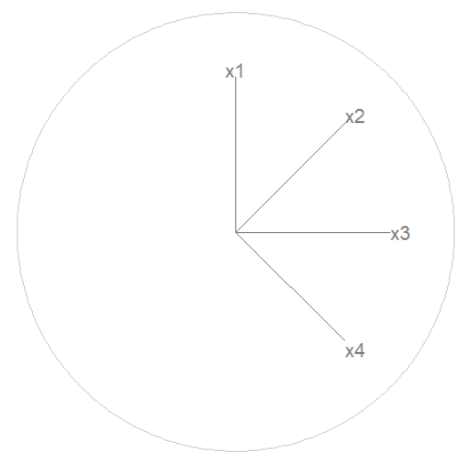
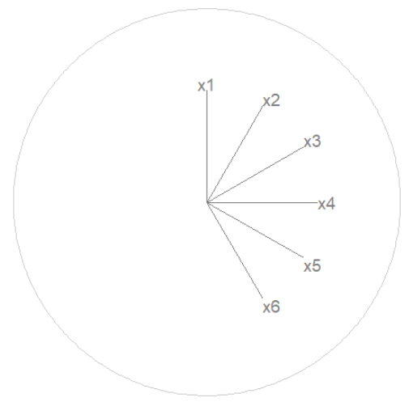
Basis, “uniform half clock”
Want to minimize the effect rotating 1 variable has on other variable;
Only use half the unit circle, nothing opposite any variable
Want an agnostic, fair starting basis;
evenly spaced, same magnitude contribution

Slide 7
Consider a new participant, suppose they are 64^{-th,} full permutation number 1 + (64 - 1) mod 36 = 28. Set the factor order, location, and vc order:
Period 1
Period 2
Period 3
Factor order
permutations
Set the factor
1 + (8 - 1) mod 3 =
Permutation 2;
Grand, Radial, PCA
1
2
3
P
G
R
OLD DESIGN
Set location pair 1 + floor((8 - 1) / 6) mod 36 = Permutation 2; 0_1, 50_50 (order flipped for period 2)
G
R
P
Set the factor 1 + (8 - 1) mod 6 = Permutation 2; PCA, Radial, Grand
Set VC order 1 + floor((8 - 1)/ 36) mod 3 = Permutation 1; EEE
R
P
G
Location
permutations
Rep 1
Rep 2
Period 1
Period 2
Period 3
Period 1
Period 2
Period 3
Location
permutations
Period 1
Period 2
Period 3
1
2
3
4
5
6
Set location pair
1 + floor((8 - 1) / 6) mod 6 =
Permutation 2; 0_1, 50_50
(order flipped for period 2)
1
2
Factor order
permutations
VC
permutations
1
3
2
3
1
2
3
4
5
6
1
2
1
2
3
4
5
6
1
1
2
3
2
1
P
G
R
1
3
3
1
P
R
G
2
3
3
2
G
R
P
2
1
VC order
permutations
G
P
R
3
1
Rep 1
Rep 2
R
P
G
3
2
1
2
3
4
5
6
R
P
G
Set VC order
1 + floor((8 - 1)/ 9) mod 6 =
Permutation 2;
EEE, banana
1
2
1
3
2
3
2
1
3
1
Even evaluation every 6*6*3*1 = 56 participants
3x training sets of EEE_4p_1_0 ; 3 training sets
3x reps from each of the 18 VC*var*location levels; 108 evaluation sets
(3 + 108) 3x factors saved as .png and .gif; 333 .png/.gif files
NEEDS MORE? Maybe 9x to fit the logic or 3 reps. 3x grand tour paths; (1x p4 training, 1x p4, 1x p6)
3
2

Slide 8





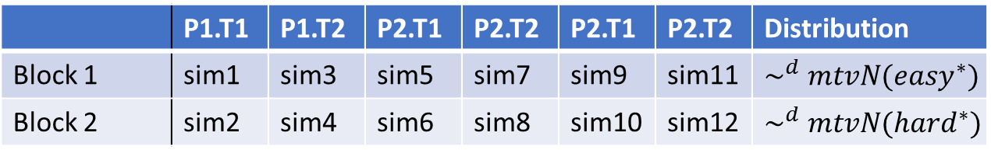
Experimental design graphics v4
OLD DESIGN
 | Period 1 | Period 2 | Period 3
Gp1 (1/3*n) | Factor 1 | Factor 2 | Factor 3
Gp2 (1/3*n) | Factor 2 | Factor 3 | Factor 1
Gp3 (1/3*n) | Factor 3 | Factor 1 | Factor 2
$$\sim ^{d} mtvN({easy}^{∗})$$
A
$$\sim ^{d} mtvN({hard}^{∗})$$
 | P1.T1 | P1.T2 | P2.T1 | P2.T2 | P2.T1 | P2.T2 | Distribution
Block 1 | sim1 | sim3 | sim5 | sim7 | sim9 | sim11 | $$\sim ^{d} mtvN({easy}^{∗})$$
Block 2 | sim2 | sim4 | sim6 | sim8 | sim10 | sim12 | $$\sim ^{d} mtvN({hard}^{∗})$$
where
Factor 1: | PCA |  | Task 1: | Number of clusters
Factor 2: | Grand tour |  | Task 2: | Importance of each/every variable for distinguishing between 2 cluster
Factor 3: | Manual tour
*) Distribution difficulty discussed in detail below
Training:
sim119~(p=6, cl=3, np=2)
sim120~(p=6, cl=3, np=2)

